Slide 1
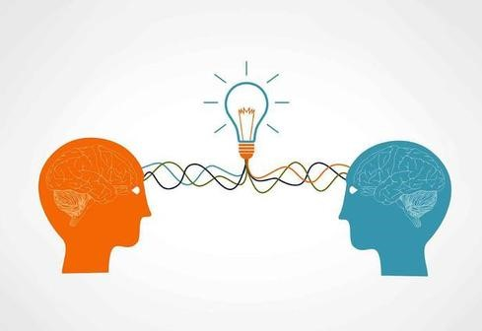
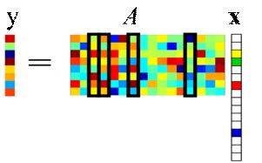
Transfer learning & dictionary learning
Jinfeng Li
20190718

Slide 2
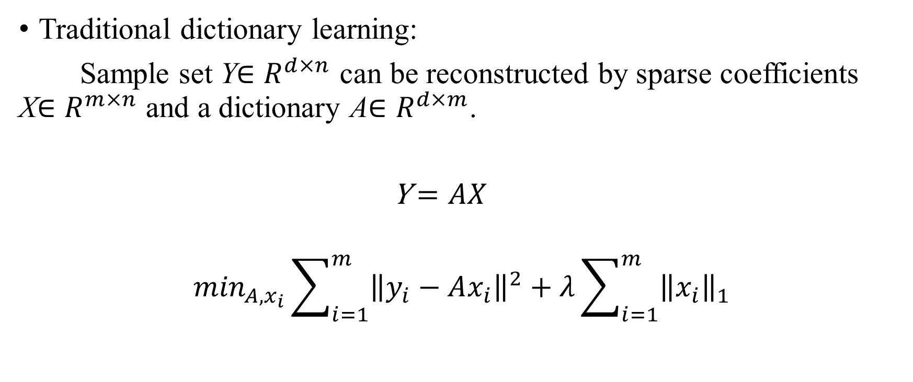
Dictionary Learning
Traditional dictionary learning:
Sample set Y$∈R^{d×n}$ can be reconstructed by sparse coefficients X$∈R^{m×n}$ and a dictionary A$∈R^{d×m}$.
Y$=AX$
$$\min_{A,x_{i}}\sum_{i=1}^{m}{{\left\|y_{i}−Ax_{i}\right\|}^{2}}+λ\sum_{i=1}^{m}{{\left\|x_{i}\right\|}_{1}}$$

Slide 3
Learning Graph regularized Sparse Codes [1]
Question: Most of the existing sparse coding approaches fail to consider the geometrical structure of the data space.
Purpose: Learn the sparse representations that take into account the local manifold structure of the data.
Method: Propose a graph-based algorithm called graph regularized sparse coding; use graph Laplacian as a smooth operator.
[1] M. Zheng, J. Bu, C. Chen, C. Wang, L Zhang, G. Qiu and D. Cai, “Graph Regularized Sparse Coding for Image Representation”, IEEE TIP, vol 20, no. 5, 2011, pp. 1327-1336.

Slide 4
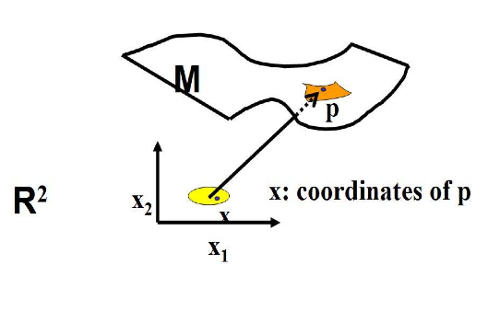
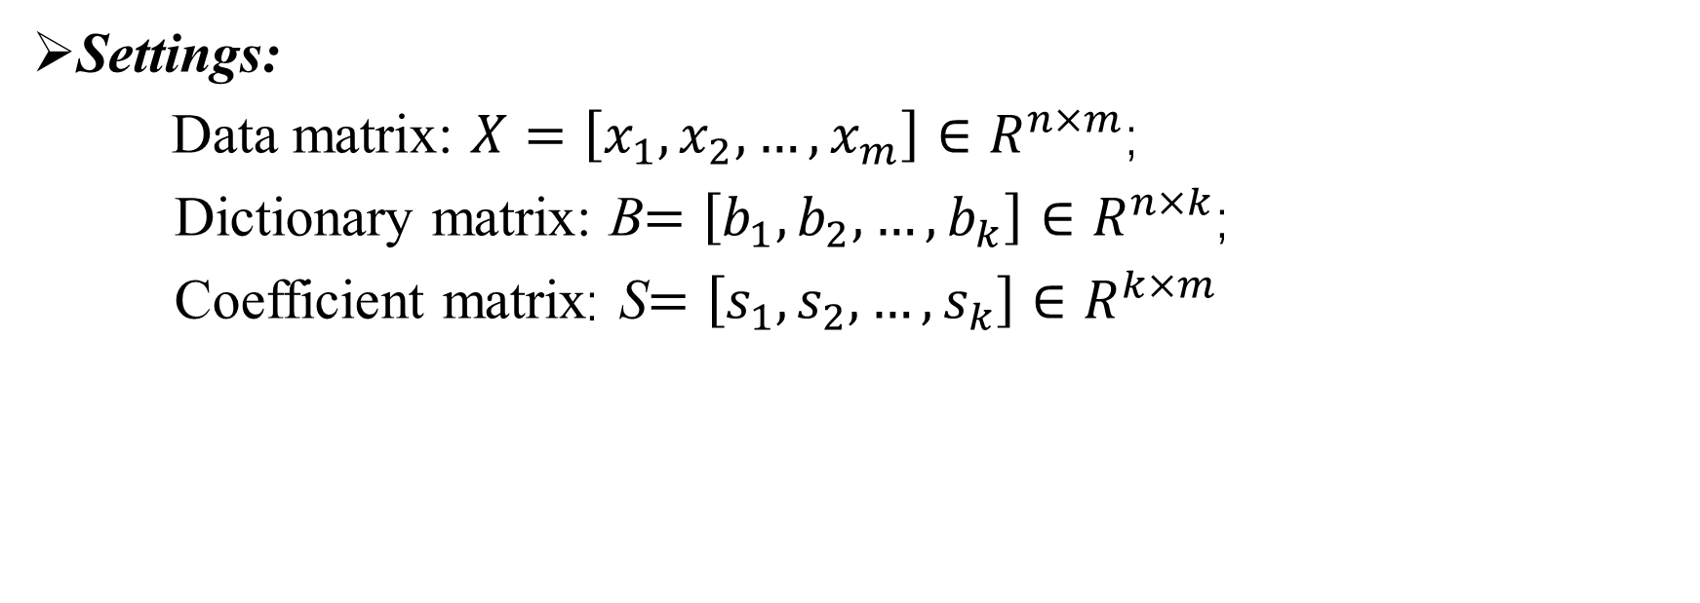
Learning Graph regularized Sparse Codes
Settings:
Data matrix: $X=\left[x_{1},x_{2},…,x_{m}\right]∈R^{n×m}$;
Dictionary matrix: B$=\left[b_{1},b_{2},…,b_{k}\right]∈R^{n×k}$;
Coefficient matrix: S$=\left[s_{1},s_{2},…,s_{k}\right]∈R^{k×m}$

Slide 5
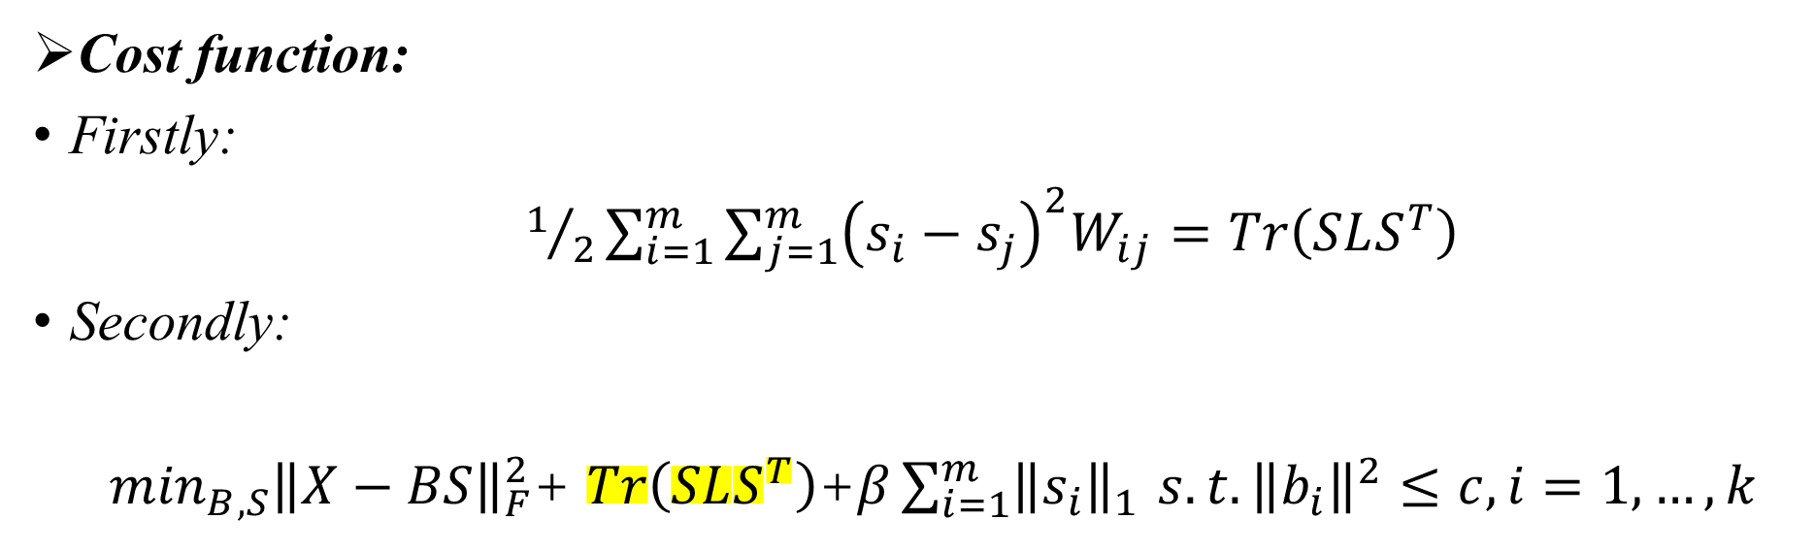
Learning Graph regularized Sparse Codes [1]
Cost function:
Firstly:
$1/2\sum_{i=1}^{m}{\sum_{j=1}^{m}{{\left(s_{i}−s_{j}\right)}^{2}W_{ij}=Tr\left(SLS^{T}\right)}}$
Secondly:
$\min_{B,S}{\left\|X−BS\right\|}_{F}^{2}$+ $Tr\left(SLS^{T}\right)$+$β\sum_{i=1}^{m}{{\left\|s_{i}\right\|}_{1 }s.t. {\left\|b_{i}\right\|}^{2}≤c, i=1,…,k}$

Slide 6
Shared Domain-adapted Dictionary Learning (SDDL) [2]
Question: When the target data have a different distribution from source data, the learned sparse representation may not be optimal.
Purpose: The author investigates if it is possible to optimally represent both source and target by a common dictionary.
Method: A technique which jointly learns projections of data in the two domains and a latent dictionary that can represent both the domains in the projected low-dimensional space..
[2] S. Shekhar, V. Patel, H. Nguyen, and R. Chellappa, “Generalized domain-adaptive dictionaries,” in CVPR, 2013, pp, 361-368

Slide 7
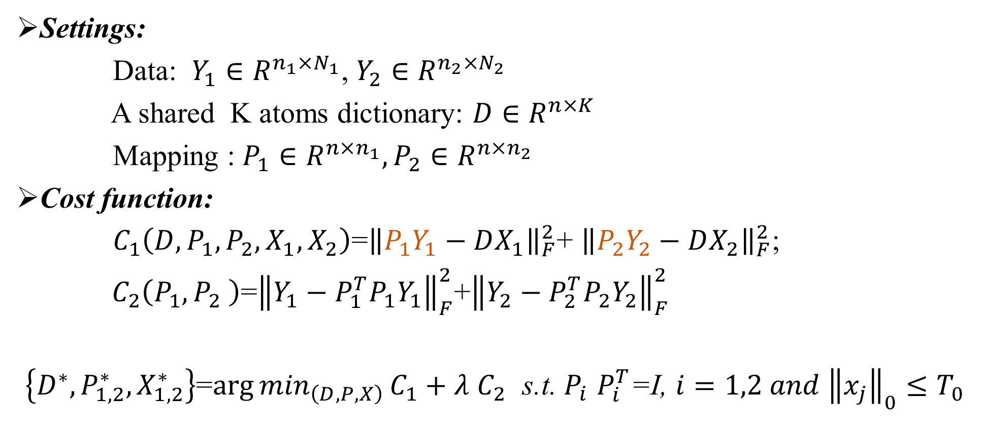
Shared Domain-adapted Dictionary Learning (SDDL)
Settings:
Data: $Y_{1}∈R^{n_{1}×N_{1}}$, $Y_{2}∈R^{n_{2}×N_{2}}$
A shared K atoms dictionary: $D∈R^{n×K}$
Mapping : $P_{1}∈R^{n×n_{1}}, P_{2}∈R^{n×n_{2}}$
Cost function:
$C_{1}\left(D, P_{1},P_{2},X_{1},X_{2}\right)$=${\left\|P_{1}Y_{1}−DX_{1}\right\|}_{F}^{2}$+ ${\left\|P_{2}Y_{2}−DX_{2}\right\|}_{F}^{2}$;
${ C}_{2}\left(P_{1},P_{2} \right)$=${\left\|Y_{1}−P_{1}^{T}P_{1}Y_{1}\right\|}_{F}^{2}$+${\left\|Y_{2}−P_{2}^{T}P_{2}Y_{2}\right\|}_{F}^{2}$
$\left\{D^{∗}, P_{1,2}^{∗},X_{1,2}^{∗}\right\}$=${\arg{min}}_{\left(D,P,X\right)}C_{1}+λ$ $C_{2}$ s.t. $P_{i}$ $P_{i}^{T}$=I, $i=1,2 and {\left\|x_{j}\right\|}_{0}≤T_{0}$

Slide 8
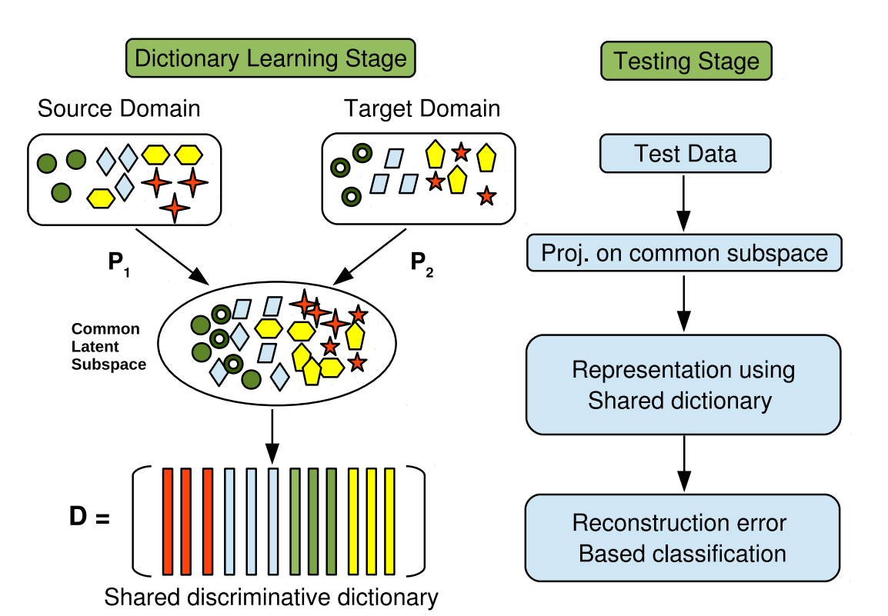
Shared Domain-adapted Dictionary Learning (SDDL)

Slide 9
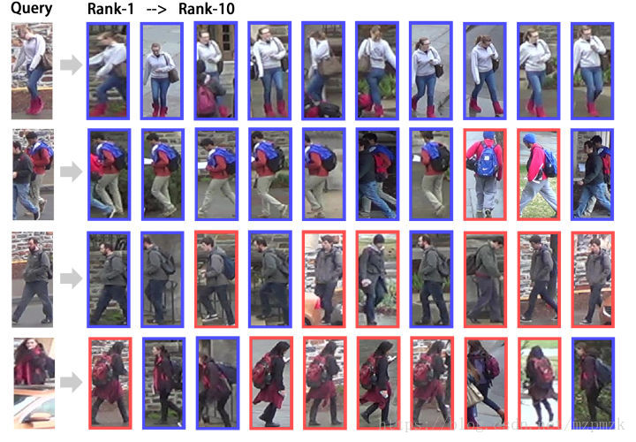
Cross-view Projective Dictionary Learning (CPDL) [3]
Question: Existing person re-identification mainly focus on extracting patch-level features or learning distance metrics. However, the representation power of extracted features might be limited, due to the various viewing conditions of pedestrian image in reality.
Purpose: To improve the representation power of feature.
Method: The authors learn discriminative and robust representations via the adaptively learned dictionaries.
[3] S. Li, M. Shao, and Y. Fu, “Cross-view projective dictionary learning for person re-identification,” in IJCAI, 2015

Slide 10
Cross-view Projective Dictionary Learning (CPDL)
Method: The authors learn discriminative and robust representations via dictionary learning.
Firstly, the author proposes a cross-view projective dictionary learning (CPLD) approach to learn effective features for persons across different views.
Secondly, design two objectives to learn low-dimensional representations for each pedestrian in patch-level and the image-level by using CPLD.
Finally, a fusion strategy is utilized to generate the similarity scores.

Slide 11
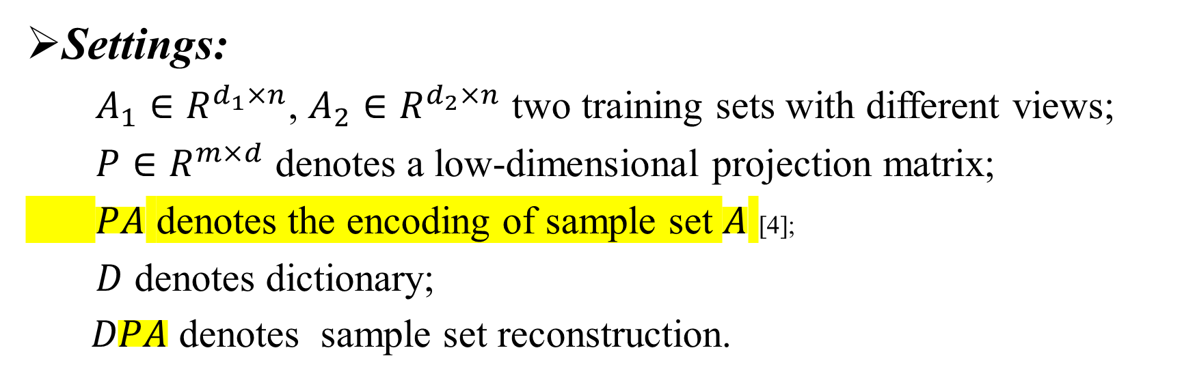
Cross-view Projective Dictionary Learning (CPDL)
Settings:
$A_{1}∈R^{d_{1}×n}$, $A_{2}∈R^{d_{2}×n}$ two training sets with different views;
$P∈R^{m×d}$ denotes a low-dimensional projection matrix;
$PA$ denotes the encoding of sample set $A$ [4];
$D$ denotes dictionary;
$DPA$ denotes sample set reconstruction.
[4] S. Gu, L. Zhang, W. Zuo, and X. Feng, “Projective Dictionary Pair Learning for Pattern Classification,” In NIPS 2014

Slide 12
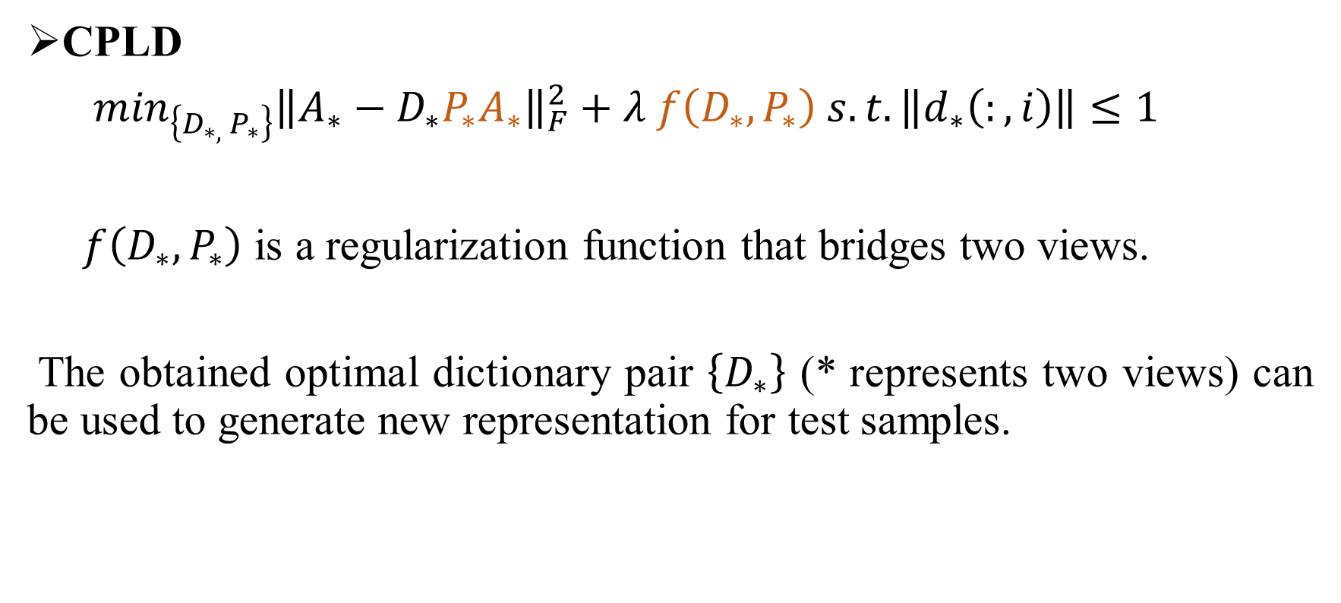
Cross-view Projective Dictionary Learning (CPDL)
CPLD
$\min_{\left\{D_{∗, }P_{∗}\right\}}{\left\|A_{∗}−D_{∗}P_{∗}A_{∗}\right\|}_{F}^{2}+λ f\left(D_{∗},P_{∗}\right) s.t. \left\|d_{∗}\left(:,i\right)\right\|≤1$
$f\left(D_{∗},P_{∗}\right)$ is a regularization function that bridges two views.
The obtained optimal dictionary pair $\left\{D_{∗}\right\}$ (* represents two views) can be used to generate new representation for test samples.

Slide 13
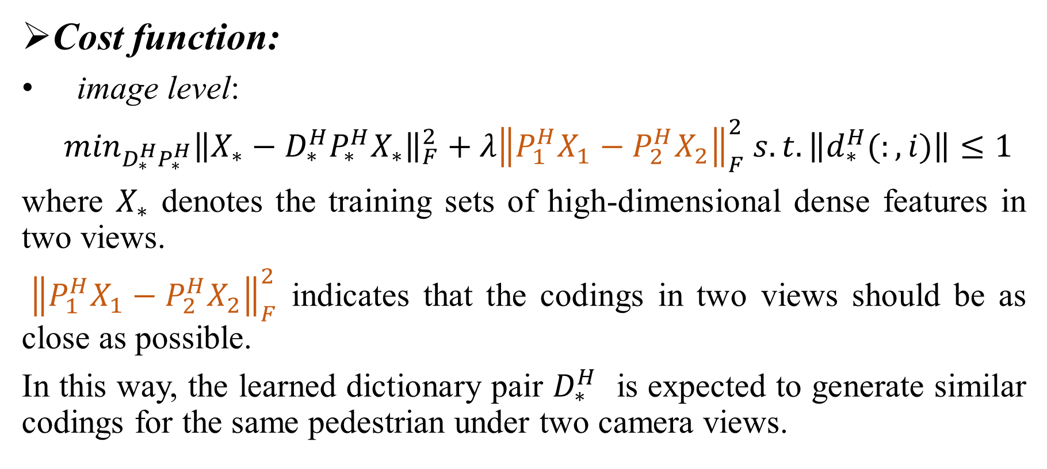
Cross-view Projective Dictionary Learning (CPDL)
Cost function:
image level:
$\min_{D_{∗}^{H}P_{∗}^{H}}{\left\|X_{∗}−D_{∗}^{H}P_{∗}^{H}X_{∗}\right\|}_{F}^{2}+λ{\left\|P_{1}^{H}X_{1}−{P_{2}^{H}X}_{2}\right\|}_{F}^{2} s.t. \left\|d_{∗}^{H}(:,i)\right\|≤1$
where $X_{∗}$ denotes the training sets of high-dimensional dense features in two views.
${\left\|P_{1}^{H}X_{1}−{P_{2}^{H}X}_{2}\right\|}_{F}^{2}$ indicates that the codings in two views should be as close as possible.
In this way, the learned dictionary pair $D_{∗}^{H}$ is expected to generate similar codings for the same pedestrian under two camera views.

Slide 14
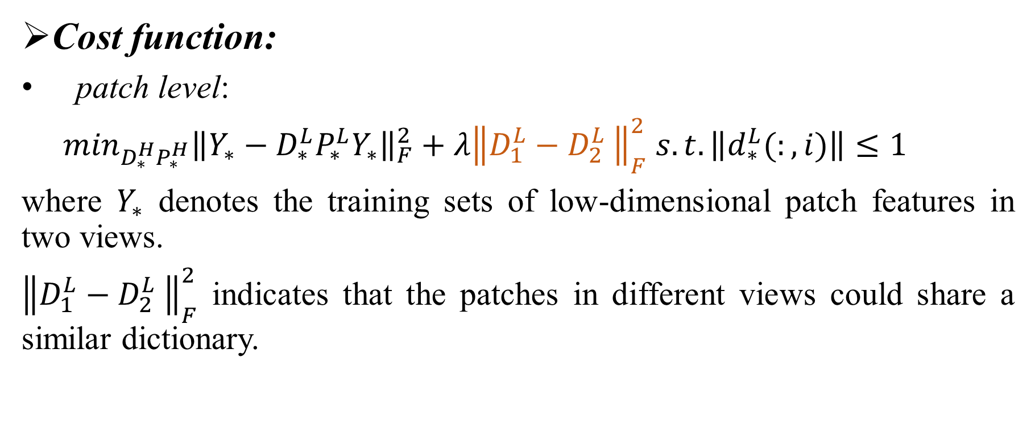
Cross-view Projective Dictionary Learning (CPDL)
Cost function:
patch level:
$\min_{D_{∗}^{H}P_{∗}^{H}}{\left\|Y_{∗}−D_{∗}^{L}P_{∗}^{L}Y_{∗}\right\|}_{F}^{2}+λ{\left\|D_{1}^{L}−{D_{2}^{L}}_{ }\right\|}_{F}^{2} s.t. \left\|d_{∗}^{L}(:,i)\right\|≤1$
where $Y_{∗}$ denotes the training sets of low-dimensional patch features in two views.
${\left\|D_{1}^{L}−{D_{2}^{L}}_{ }\right\|}_{F}^{2}$ indicates that the patches in different views could share a similar dictionary.

Slide 15
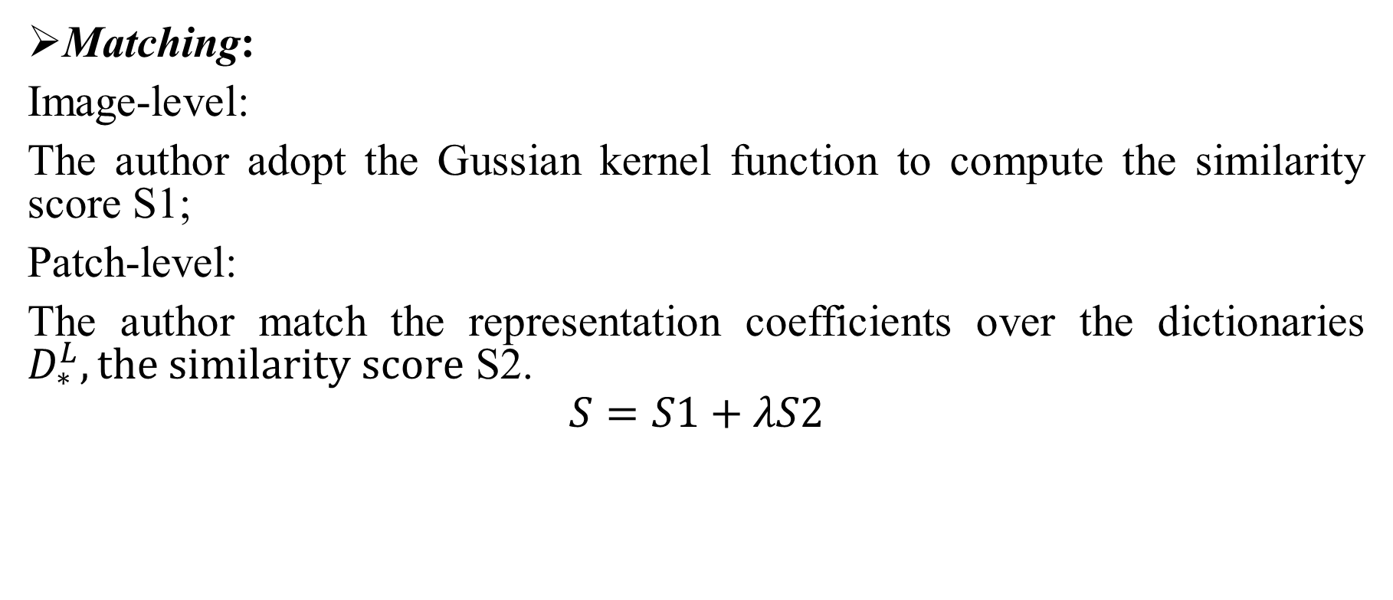
Cross-view Projective Dictionary Learning (CPDL)
Matching:
Image-level:
The author adopt the Gussian kernel function to compute the similarity score S1;
Patch-level:
The author match the representation coefficients over the dictionaries $D_{∗}^{L}, the similarity score$ S2.
$$S=S1+λS2$$

Slide 16
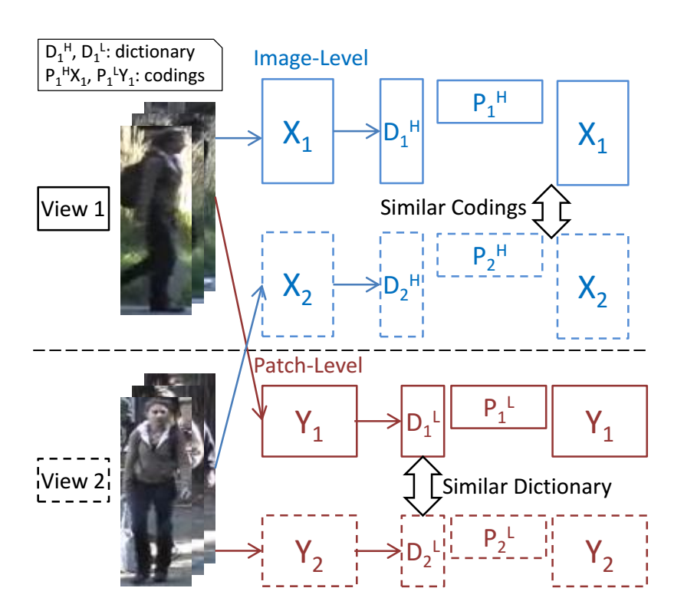
Cross-view Projective Dictionary Learning (CPDL)

Slide 17
Subspace Interpolation via Dictionary Learning for Unsupervised Domain [5]
Question: As the dictionary atoms learned from one domain are not optimal to fit a different domain, and only a small subset of atoms are allowed for representation. It will incur large reconstruction errors for the target data.
Purpose: Adapt classification system from source domain to target domain.
Method: Sample several intermediate domains along a virtual path between the source and target domains, and represent each intermediate domain using a dictionary.
[5] J. Ni, Q. Qiu, and R. Chellappa, “Subspace interpolation via dictionary learning for unsupervised domain adaptation,” in CVPR, 2013, pp. 692–699.

Slide 18
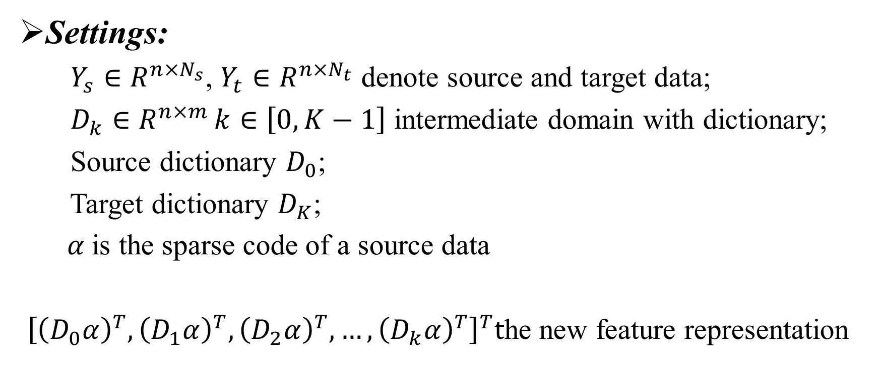
Subspace Interpolation via Dictionary Learning for Unsupervised Domain
Settings:
$Y_{s}∈R^{n×N_{s}}$, $Y_{t}∈R^{n×N_{t}}$ denote source and target data;
$D_{k}∈R^{n×m }k∈\left[0,K−1\right]$ intermediate domain with dictionary;
Source dictionary $D_{0}$;
Target dictionary $D_{K}$;
$α$is the sparse code of a source data
${\left[{\left(D_{0}α\right)}^{T},{\left(D_{1}α\right)}^{T},{\left(D_{2}α\right)}^{T},…,{\left(D_{k}α\right)}^{T}\right]}^{T}t$he new feature representation

Slide 19
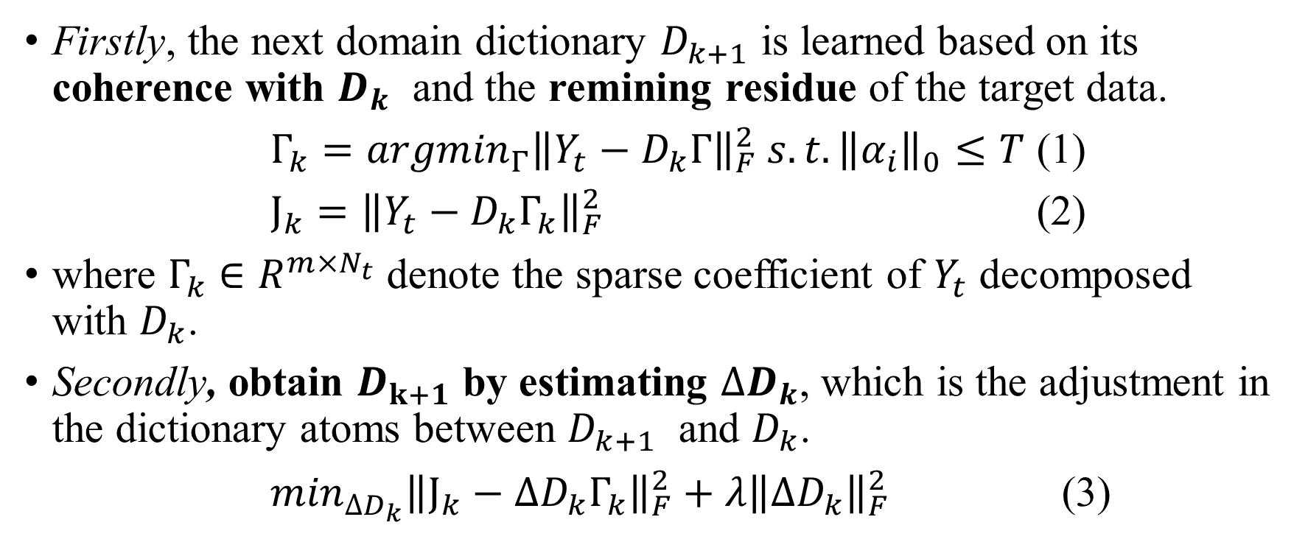
Subspace Interpolation via Dictionary Learning for Unsupervised Domain
Firstly, the next domain dictionary $D_{k+1}$ is learned based on its coherence with $D_{k}$ and the remining residue of the target data.
$Γ_{k}={argmin}_{Γ}{\left\|Y_{t}−D_{k}Γ\right\|}_{F}^{2} s.t. {\left\|α_{i}\right\|}_{0}≤T$ (1)
$J_{k}={\left\|Y_{t}−D_{k}Γ_{k}\right\|}_{F}^{2}$ (2)
where $Γ_{k}$ $∈R^{m×N_{t}}$ denote the sparse coefficient of $Y_{t}$ decomposed with $D_{k}$.
Secondly, obtain $D_{k+1}$ by estimating $∆D_{k}$, which is the adjustment in the dictionary atoms between $D_{k+1}$ and $D_{k}$.
$\min_{∆D_{k}}{\left\|J_{k}−∆D_{k}Γ_{k}\right\|}_{F}^{2}+λ{\left\|∆D_{k}\right\|}_{F}^{2}$ (3)

Slide 20
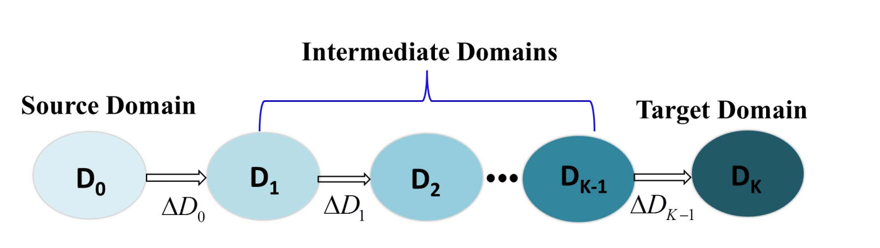

Subspace Interpolation via Dictionary Learning for Unsupervised Domain
Finally, $D_{k+1}=$ $D_{k+1}$+ $∆D_{k}$ (4)

Slide 21
Thank you

